Slide 1

Data Collection, Data Cleaning and EDA

Slide 2
About me
I am S.Indudarshini, B-Tech 4th year student in Electronics and Communication Engineering (ECE) at Malla Reddy College of Engineering and Technology. I am passionate about data science because it merges my interests in technology and problem-solving. In my view, data science is an essential field that plays a pivotal role in today’s data-driven world. It empowers organizations to make informed decisions by transforming raw data into actionable insights, which reduces reliance on intuition and guesswork. The ability to analyze data enhances efficiency, allowing businesses to optimize processes and allocate resources effectively. Moreover, data science fosters innovation by enabling personalized experiences in sectors like marketing and healthcare, ultimately improving customer satisfaction and patient outcomes. As the demand for data-driven insights continues to grow, mastering data science not only opens up numerous career opportunities but also equips me to contribute meaningfully to addressing societal challenges. I believe that by harnessing the power of data, we can drive positive change and create a significant impact across various industries.
LinkedIn: https://www.linkedin.com/in/indudarshini-s-989138333
GitHub: https://github.com/IndudarshiniS

Slide 3
Introduction
In this project, I focused on analyzing data collected from the Cars24 website, a leading platform for buying and selling used cars. The dataset includes key features such as car price, rating, name, model, year of manufacture, mileage, fuel type, and more. The primary objective of this analysis is to uncover trends and insights within the used car market, addressing critical business questions related to pricing strategies, customer preferences, and market demand. Throughout this presentation, I will guide you through the business problem, the objectives of the project, the web scraping process, and the exploratory data analysis conducted to extract valuable insights from the collected data.

Slide 4
Objective of the Project
The primary objective of this project is to leverage data analytics to address the challenges faced in the used car market, particularly in pricing strategies, consumer preferences, and inventory management. Specifically, the project aims to analyze the relationship between various car features such as model, mileage, fuel type and their corresponding market prices to identify key determinants influencing pricing. Additionally, it seeks to uncover trends in consumer preferences by examining ratings and specific features, enabling dealerships and sellers to align their inventory with market demand. The project will also provide actionable insights for optimizing pricing and inventory strategies, establish a framework for monitoring market trends and fluctuations, and promote data-driven decision-making among stakeholders. By achieving these objectives, the project aspires to enhance the competitiveness and profitability of dealerships and individual sellers in the dynamic used car market.

Slide 5
Web Scraping – Details
For this project, I focused on Cars24, a leading platform for buying and selling used cars, which offers extensive listings and detailed specifications.
Process Followed
Focused on key data points such as Name, model, mileage, price, fuel type, and ratings.
Tools and Libraries: I used Python along with some libraries:
Beautiful Soup: For parsing HTML.
Requests: To retrieve web content.
Pandas: For data manipulation and storage.
NumPy: For numerical operations.
re: For data cleaning with regular expressions.
Matplotlib and Seaborn: For data visualization.

Slide 6
Scraping Scripts: Developed Python scripts to navigate Cars24, extract data, and handle pagination.
Data Cleaning: Cleaned the scraped data to remove duplicates and standardize formats, then stored it in a CSV file.
Compliance: Followed Cars24’s terms of service and implemented respectful scraping practices.

Slide 7
Exploratory Data Analysis (EDA)
Data Cleaning Steps
DataFrame: I Created a DataFrame with required columns.
Check for Missing Values: Identified any missing values in the dataset.
Handle Missing Values: Decided how to handle missing data.(using: fillna, drop columns)
Remove Duplicates: Checked for duplicates and removed any duplicate entries.
Data Type Conversion: Ensured that all columns have the correct data types.
Standardize Formats: Cleaned and standardized formats (e.g., removed currency symbols, standardized text).
CSV file: Created a csv file with the dataframe.

Slide 8
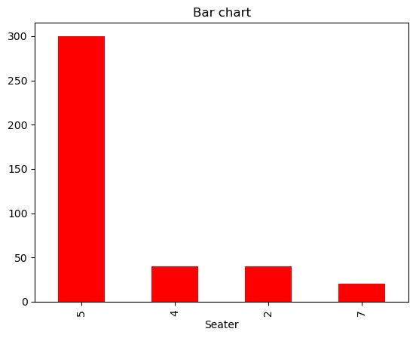
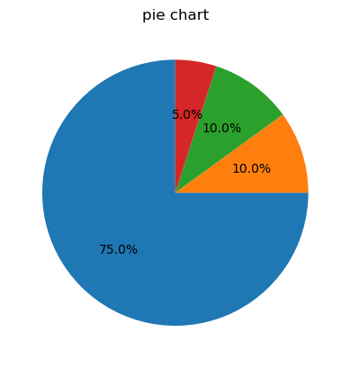
Univariate analysis
Categorical data (qualitative)
1. Bar graph
2. Pie chart

Slide 9
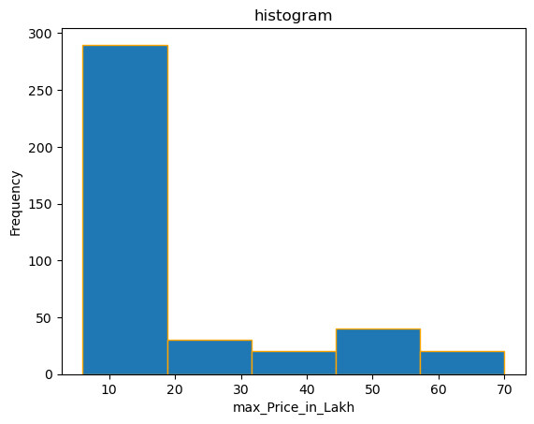
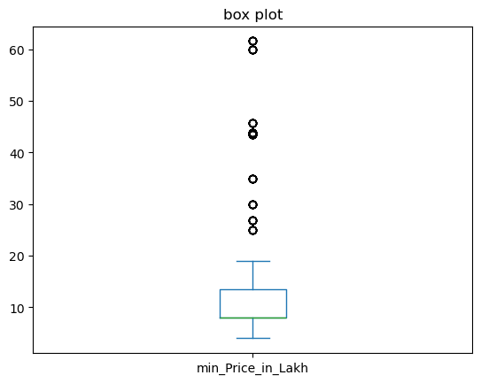
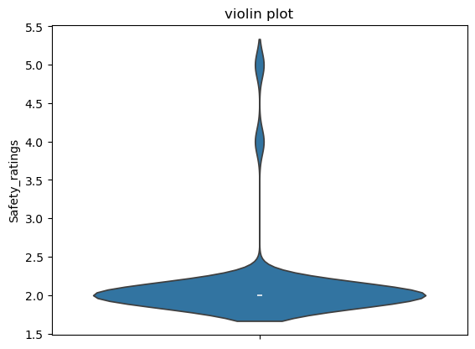
Numerical data (quantitative)
1. Histogram
2. Box plot
3. Violin plot

Slide 10
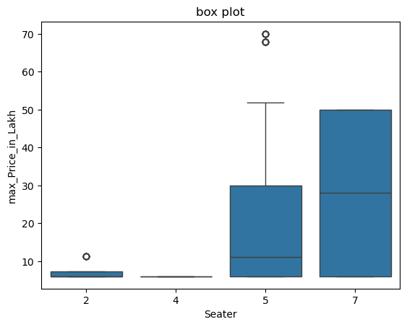
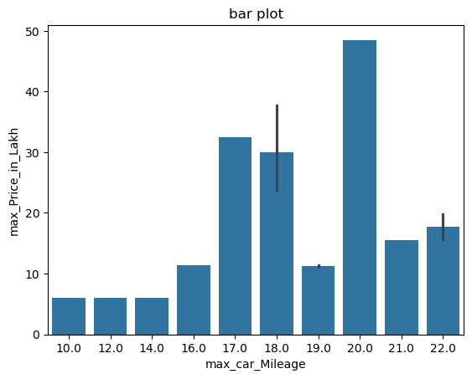
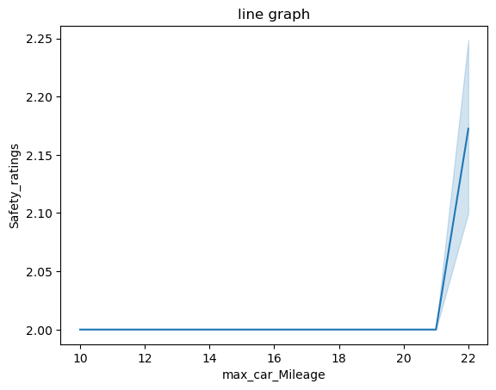
Bivariate analysis
Continuous and Categorical variables
1. Box plot 2. Bar plot 3. Line graph

Slide 11
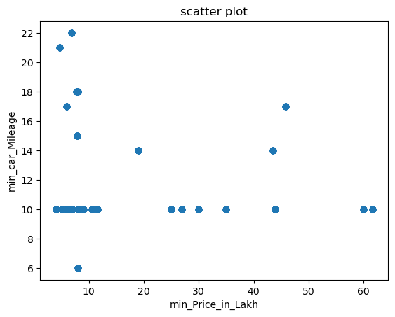
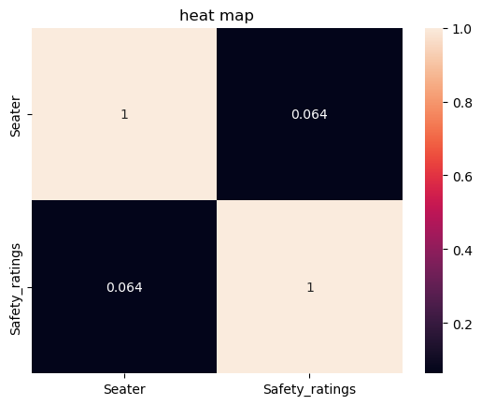
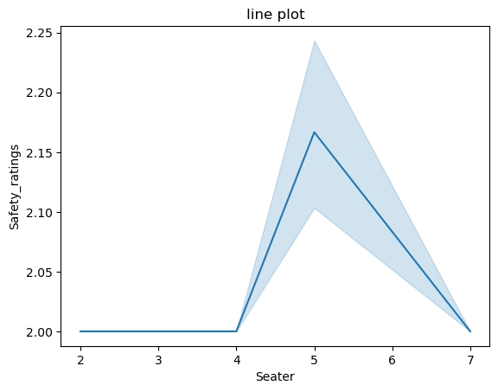
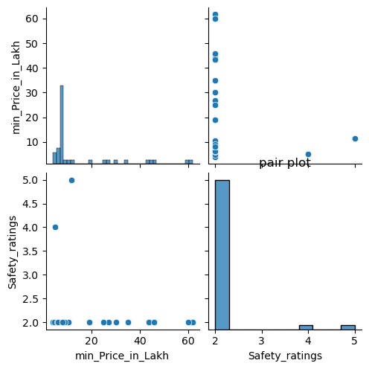
Continuous to Continuous variable
1. Scatter plot
2. Pair plot
3. Heat map
4. Line graph

Slide 12
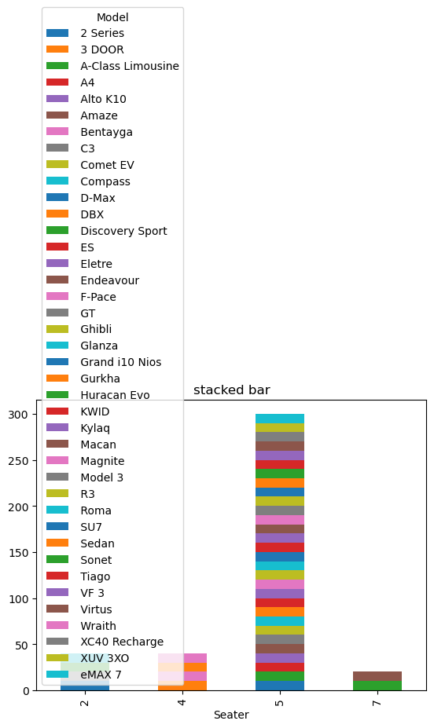
Categorical to Categorical variables
1. Stacked bar

Slide 13
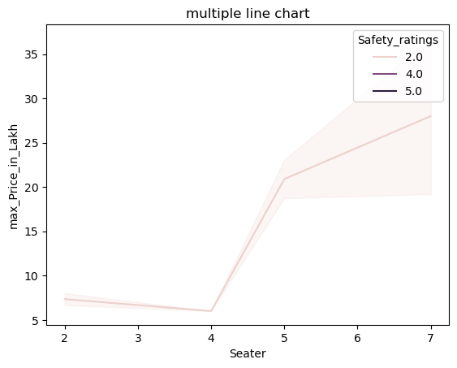
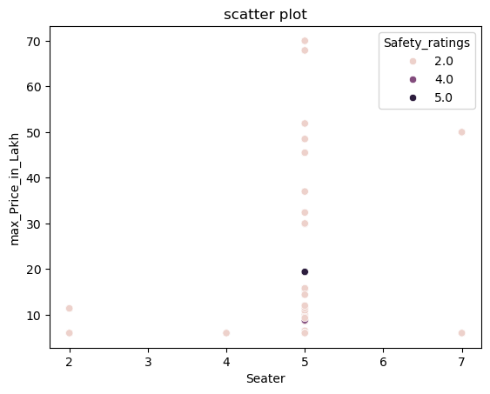
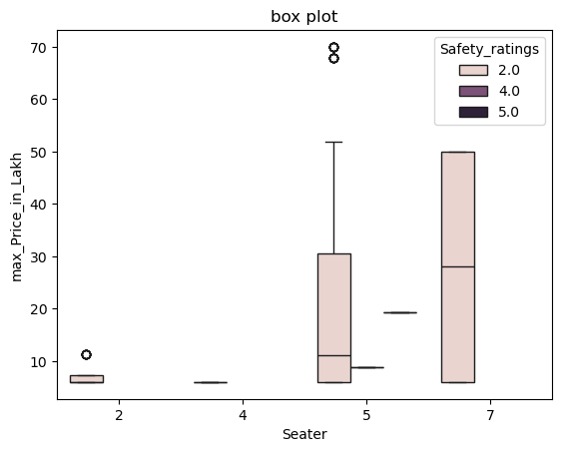
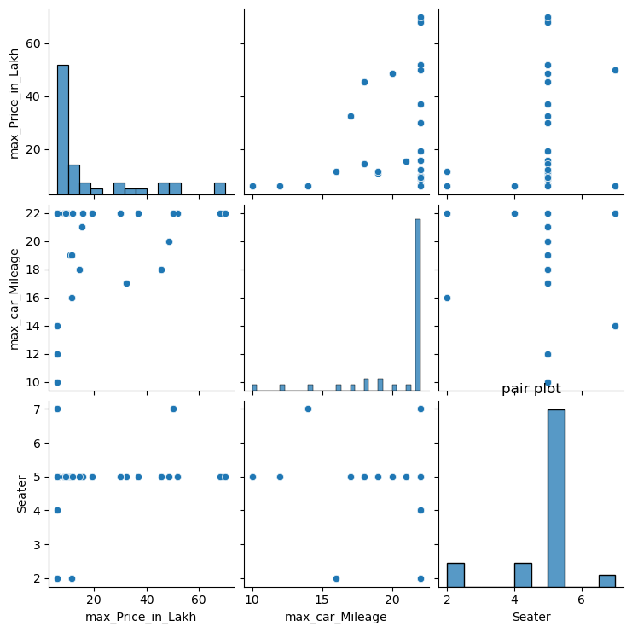
Multivariate analysis
1. Pair plot
2.Multiple line chart
3. Scatter plot
4. Box plot

Slide 14
Key Business Question
• How do various factors such as rating, model, mileage, and fuel type influence the pricing of used cars on the Cars24 platform?

Slide 15
Conclusion
The analysis reveals that several key factors significantly influence the pricing of used cars. The model of the vehicle is essential, with certain brands commanding higher prices. Interestingly, higher mileage is associated with increased prices, indicating that well-maintained vehicles with higher mileage can still hold significant value. User ratings also contribute to pricing, with cars that have better ratings typically being valued higher. Additionally, fuel type plays a role, with petrol cars generally priced lower than diesel cars. Together, these factors shape the pricing dynamics in the used car market.

Slide 16
Experience working on Web Scraping
My experience with Cars24 focused on key factors such as price, mileage, fuel type, model, and ratings. The platform provided valuable insights into how these elements influence consumer decisions in the used car market. I observed that certain models and fuel types, such as hybrids or popular brands, can command higher prices. Ratings also played a significant role, as vehicles with better reviews tended to sell for more, regardless of their mileage or fuel type. Overall, analyzing these factors helped me understand the dynamics of pricing in the used car market.

Slide 17


Slide 18

THANK YOU

